Slide 1
Application in Forensics - Detection of Image Splicing
Ishaan Abhyankar
21d100008
Anubha Vyasamudri
210100019
Mohak Vyas
210040098

Slide 2
Work Distribution
Global Noise Variance Estimation - Ishaan
Local Noise Variance Estimation- Anubha
Splicing Detection - Mohak

Slide 3
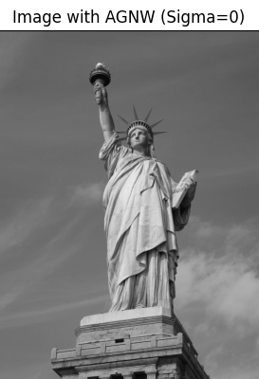
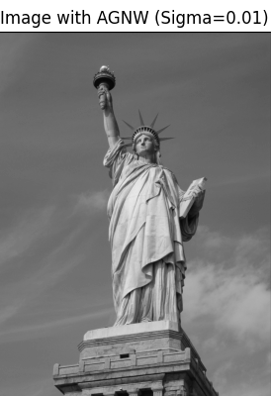

Global Noise Variance Estimation
GNV = -2.78e-05
GNV = 6.82e-05
GNV = 0.00032

Slide 4
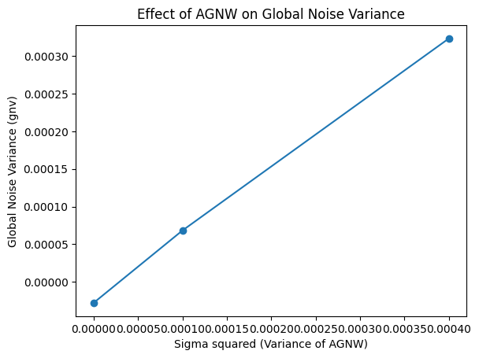
Global Noise Variance Estimation

Slide 5
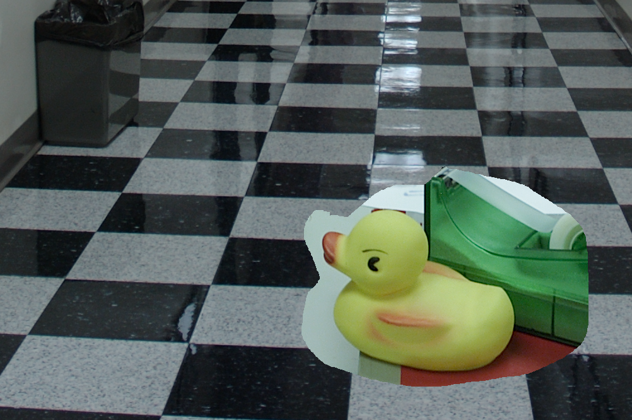
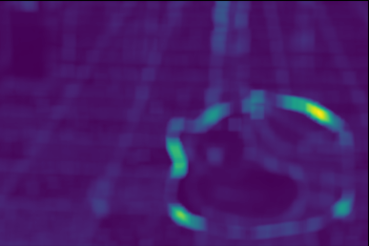
Local Noise Variance Estimation
Local Noise Variance

Slide 6
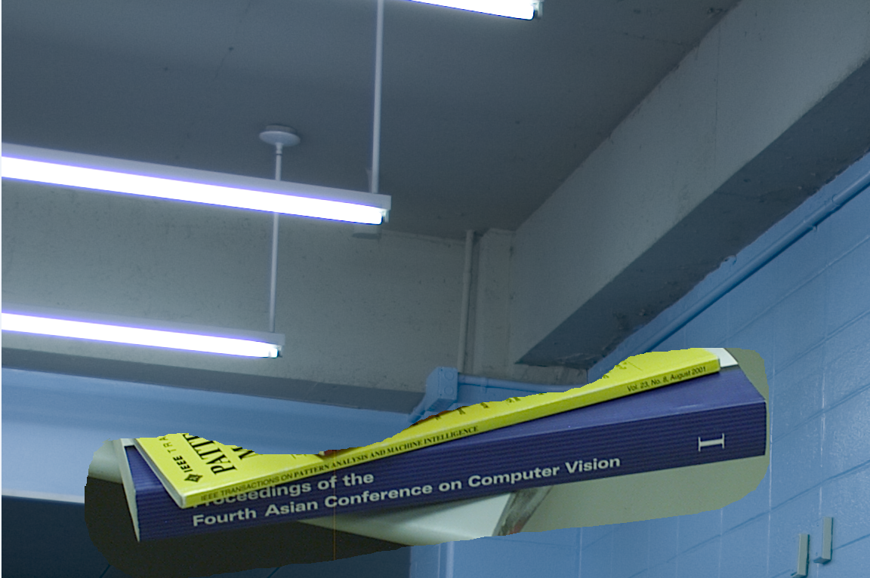
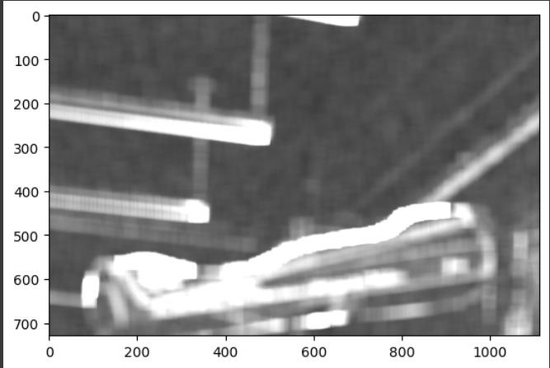
Detection of Image Splicing

Slide 7
THANK YOU

